Slide 1

SharePoint Server: The Ultimate Installation and Configuration Guide
Gursher Singh
Jason Dhaliwal
Jevin Heer

Slide 2
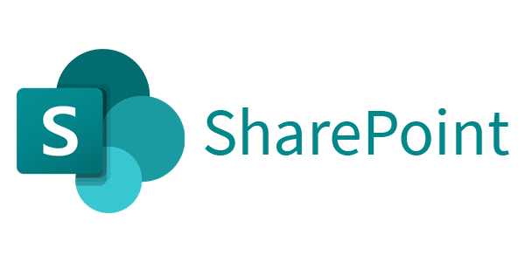
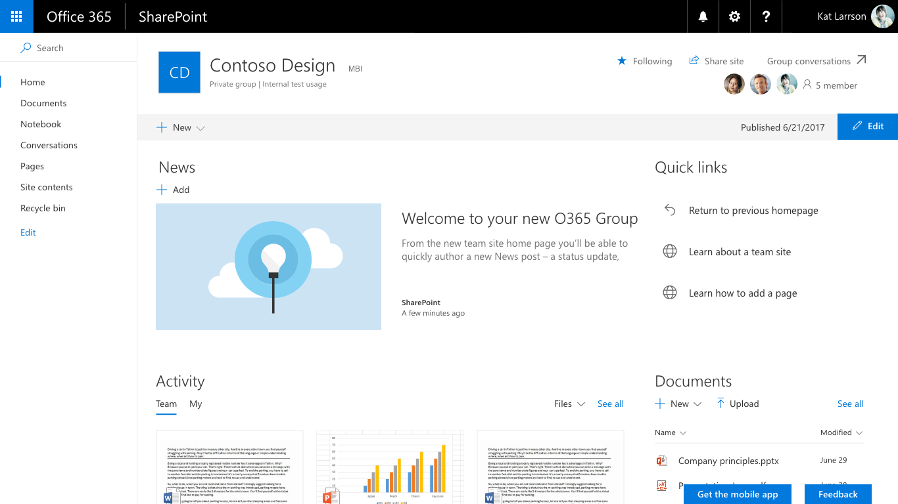
What is SharePoint

Slide 3

What is SharePoint
Web based Collaborative platform developed by Microsoft
Provides a centralized and secure location for organizations with many different features
Versions
Cloud Version
On-Permise Version (Sharepoint Server)

Slide 4
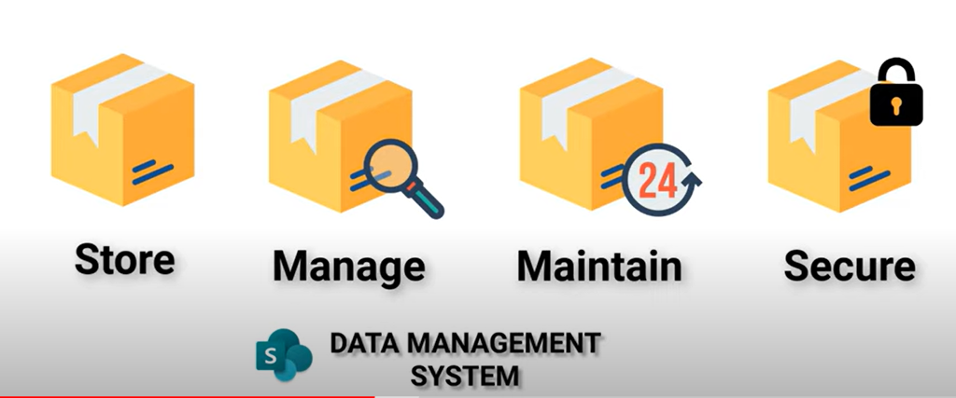
How To Use SharePoint and Get The Most Out Of It
The Main Uses
Storing of Data
Document Management
Sharing
Security and Permissions
Customization
Communication Sites and Team sites
Intranet
DLP Capabilities
Sharepoint Workflow
Mobile Access
Other Common Uses

Slide 5

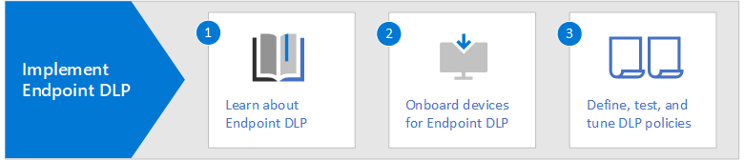
Data Loss Prevention Capabilities

Slide 6
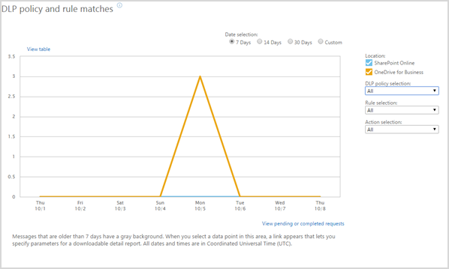
Data Loss Prevention Capabilities
Within sharepoint we have features to protect sensitive data and prevent it from being shared within the environment
Policy Creation:
Content Inspection:
User Notifications:
Monitoring and Reporting:
Integration with Microsoft 365:

Slide 7
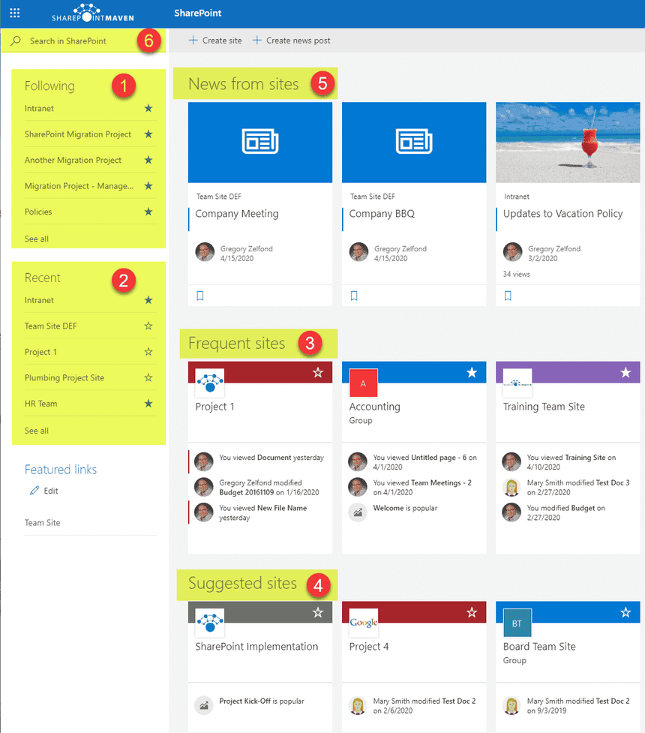

Communication Sites and Team sites
Communication Sites
Designed for interacting with a broad audience
Examples: Broadcasting news, updates and content to large groups like all employees
Team Sites
Designed for groups users working together or projects

Slide 8
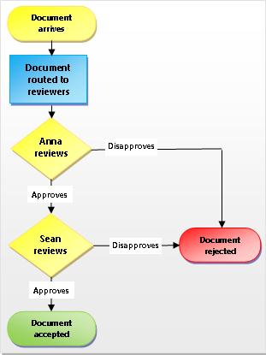
SharePoint WorkFlow
SharePoint workflows are pre-programmed mini-applications designed to automate various business processes.
Workflows streamline tasks, such as collecting signatures, feedback, approvals, and tracking procedure statuses.
The main goals of SharePoint workflows are to save time, improve efficiency, and maintain consistency in recurring tasks.
Workflows can be applied to a wide range of scenarios within SharePoint, making them versatile tools for process automation.

Slide 9
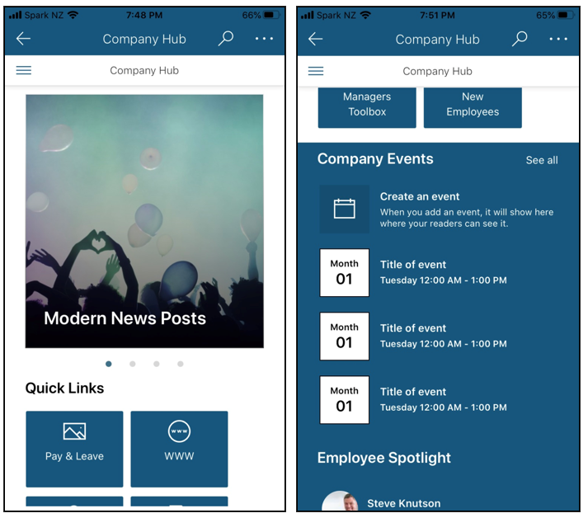
Mobile Access

Slide 10
What Is Office 365 Cloud-Based SharePoint?

Slide 11
Brief Overview
Office 365 SharePoint is a cloud-based service that allows organizations to store, organize, share and access information from any device using only a web browser.
With the cloud-based SharePoint we do not need to install and deploy SharePoint Servers on-site, but rather subscribe to Microsoft 365 or to SharePoint Online to share documents and information throughout the organization

Slide 12
Benefits vs Standard SharePoint Server
Subscription pricing: Businesses only pay for the licenses they need. This makes it easy to manage and cost-effective.
Cloud-based: Office 365 SharePoint is a cloud-based service hosted by Microsoft. This means that businesses do not need to invest in expensive hardware or software to run SharePoint.
Office 365 SharePoint also has the benefits of a regular SharePoint server such as scalability, ease of use, and supporting effortless real time collaboration.

Slide 13
Drawbacks vs Standard SharePoint Server
Data Security: While SharePoint offers advanced security features, some businesses may be reluctant to store sensitive data in the cloud. This can be a disadvantage for businesses that require a high level of data security.
Internet Connectivity: Office 365 SharePoint requires an internet connection to access and use. This can be a disadvantage for businesses that have limited or unreliable internet connectivity.
Limited Customization: Office 365 SharePoint has some limitations when it comes to customization. While it is possible to customize cloud-based SharePoint, it is not as flexible as on-site SharePoint, this can be a disadvantage for businesses that require a high degree of customization.

Slide 14
Use in Industry
Government: Government agencies use SharePoint to manage documents, automate workflows, and improve collaboration between teams.
Finance: Financial institutions use SharePoint to manage documents, automate workflows, and improve collaboration between teams.
Education: Educational institutions use SharePoint to manage student records, collaborate on research, and improve communication between faculty and staff.
Manufacturing: Manufacturing companies use SharePoint to manage product development, improve supply chain management, and improve collaboration between teams.
Healthcare: Healthcare organizations use SharePoint to manage patient records, collaborate on research, and improve communication between healthcare providers.

Slide 15
Summary
In summary, Office 365 SharePoint is a powerful tool that can help organizations improve collaboration, productivity, and efficiency. It provides a centralized hub for document sharing, document and project management, as well as real-time collaboration. It is scalable, quite secure, and easy to use.
Office 365 cloud-based SharePoint is ideal for small to medium businesses who do not want to invest in a local SharePoint server, and would rather pay a subscription for a SharePoint server hosted by Microsoft.

Slide 16
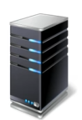
Environment for Demo Sharepoint Server
Active Directory and DNS Server
Hostname: CA-Van-JGJ-DC1
IP Address: 192.168.7.1
vCPU – 4
Memory – 4
Domain – Carabinieri.com
SQL Server
Hostname: CA-Van-SQL
IP Address: 192.168.7.3
vCPU – 4
Memory – 6
Domain – Carabinieri.com
Sharepoint Server
Hostname: CA-Van-SP
IP Address: 192.168.7.4
vCPU – 4
Memory – 6
Domain – Carabinieri.com
Client
IP Address: 192.168.7.2
vCPU – 4
Memory – 4
Domain – Carabinieri.com
Notes:
You must need an active directory infrastructure to install SharePoint.
Set up an active directory and DNS server as the first server.
Use a remote standalone SQL server for SharePoint installation.
Installing Microsoft SharePoint 2019 is straightforward with minimal configuration.
After installation, reboot the server and give additional rights to the SharePoint service account.
Run the SQL Server pre-requirements tool to install and reboot the servers.

Slide 17
Installation STEP-BY-STEP
Step 1- Install & Configure SQL Server 2019
Database engine services
Full-text and Semantic Extractions
Analysis Services
Step 2-Install SQL Server Management Studio and Give Required access to the SharePoint Service account
dbcreator
public
securityadmin
sysadmin
Notes:
Install Microsoft SharePoint 2022 using SQL Server 2019.
Make sure both servers are patched with all Windows updates.

Slide 18
Installation STEP-BY-STEP
Step 3 - Run SharePoint 2019 Pre-Requirements Installation and reboot server
Step 4 - Run the SharePoint Server 2019 Installation
Step 5 - Configure SharePoint Server 2019
Step 6-Validate SharePoint Server 2019 Installation

Slide 19
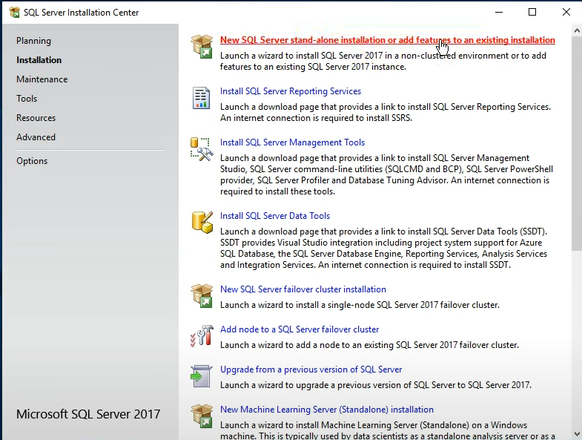
SQL installation guide

Slide 20
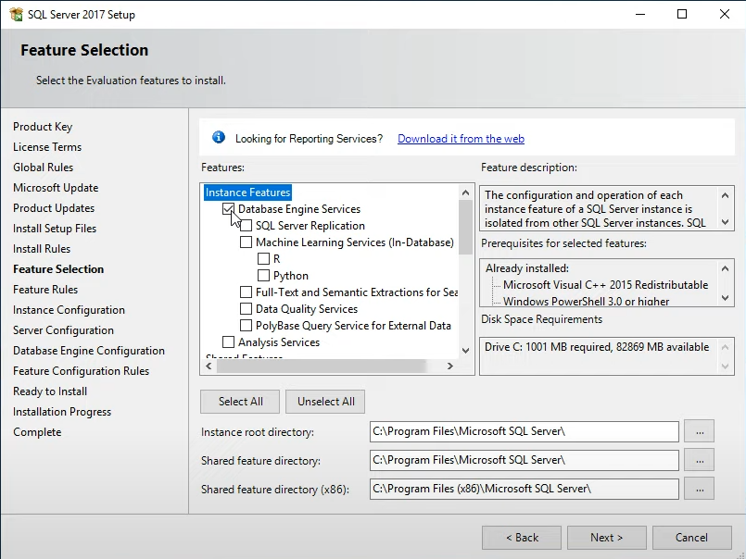
Feature Selection
DATABASE ENGINE SERVICES
This is the core service for storing, processing, and securing data, and other components that run as services in the system background and provide core operating system features.
Notes:
Select and install the required components: database engine services, full-text tools, semantic extraction and analysis services.

Slide 21
Feature Selection
FULL-TEXT AND SEMANTIC EXTRACTIONS
Enable text-based searching and analysis by adding the ability for SQL Server to determine key words in documents.

Slide 22
Feature Selection
ANALYSIS SERVICES
Provides online analytical processing (OLAP) and data mining functionality, allowing users to create and manage multidimensional structures that contain data aggregated from other data sources, such as relational databases.

Slide 23
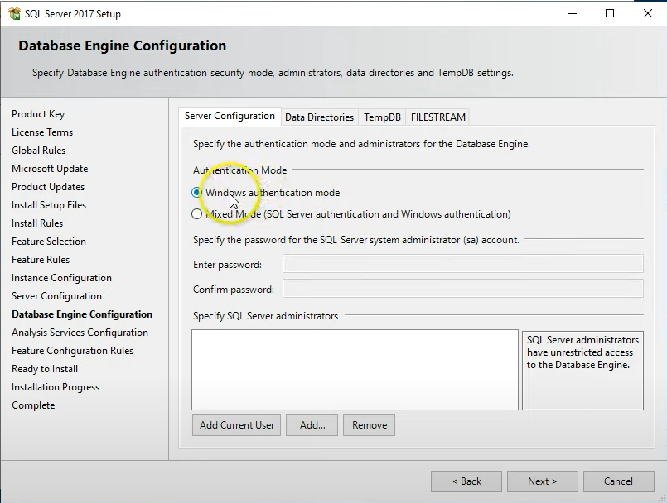
Authentication
Notes:
I am going to use the default windows authentication
Under sql server administrators add the current account which is the local admin, sharepoint admin, and anyone you want to grant the access to

Slide 24
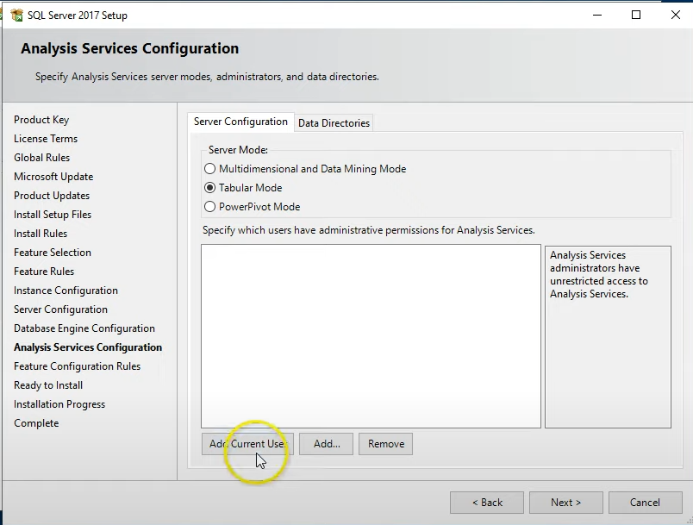
Analysis Service Configuration
Notes:
Same thing here for the analysis services we will add the current account and the SP admin account. Leave the directory as default as we don’t need to modify it.
The installation itself should take about 5/10 minutes

Slide 25
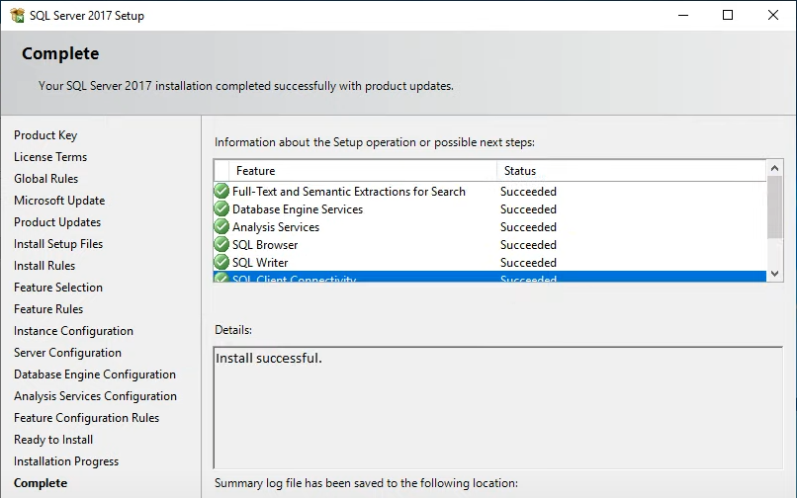
Installation of SQL Server Successful!

Slide 26
Install SQL Server Management Studio

Slide 27
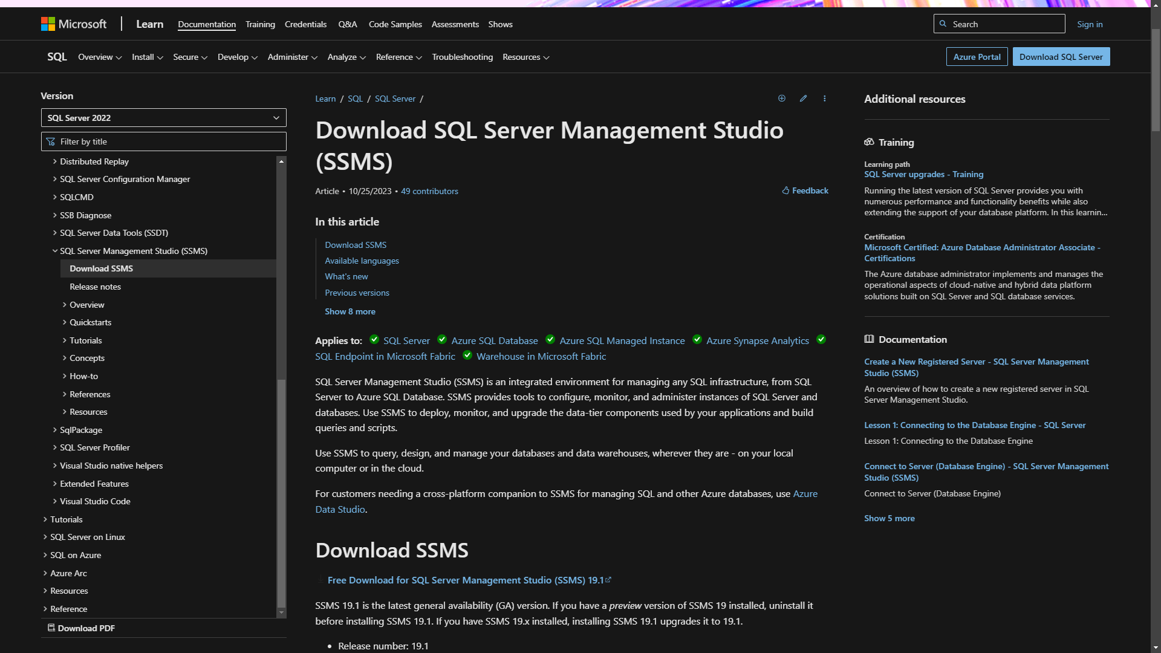
Install SQL Server Management Studio
Notes:
Now we are good to go and install the SQL server management studio setup which can be downloaded from the sql installation setup wizard we opened up earlier.

Slide 28
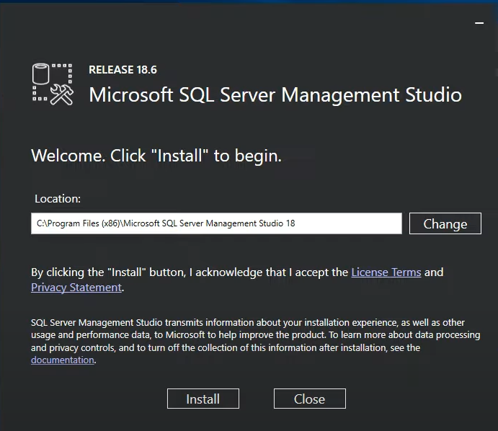
Install SQL Server Management Studio
SQL Server Management Studio (SSMS) is an integrated environment for managing SQL Server databases. It is a free tool that can be used to access, configure, manage, administer, and develop all components of SQL Server
Notes:
The installation itself is pretty straightforward and it will run in the background. We don’t customize anything on it.

Slide 29
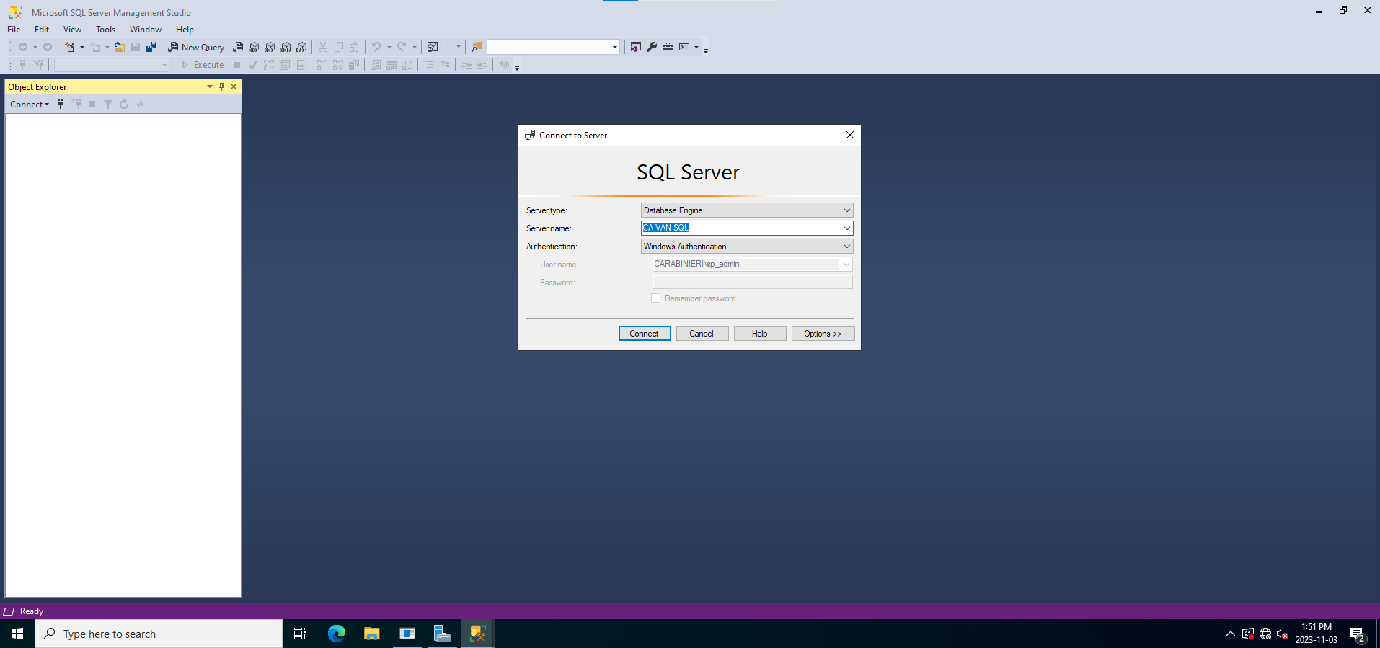
SQL Server

Slide 30
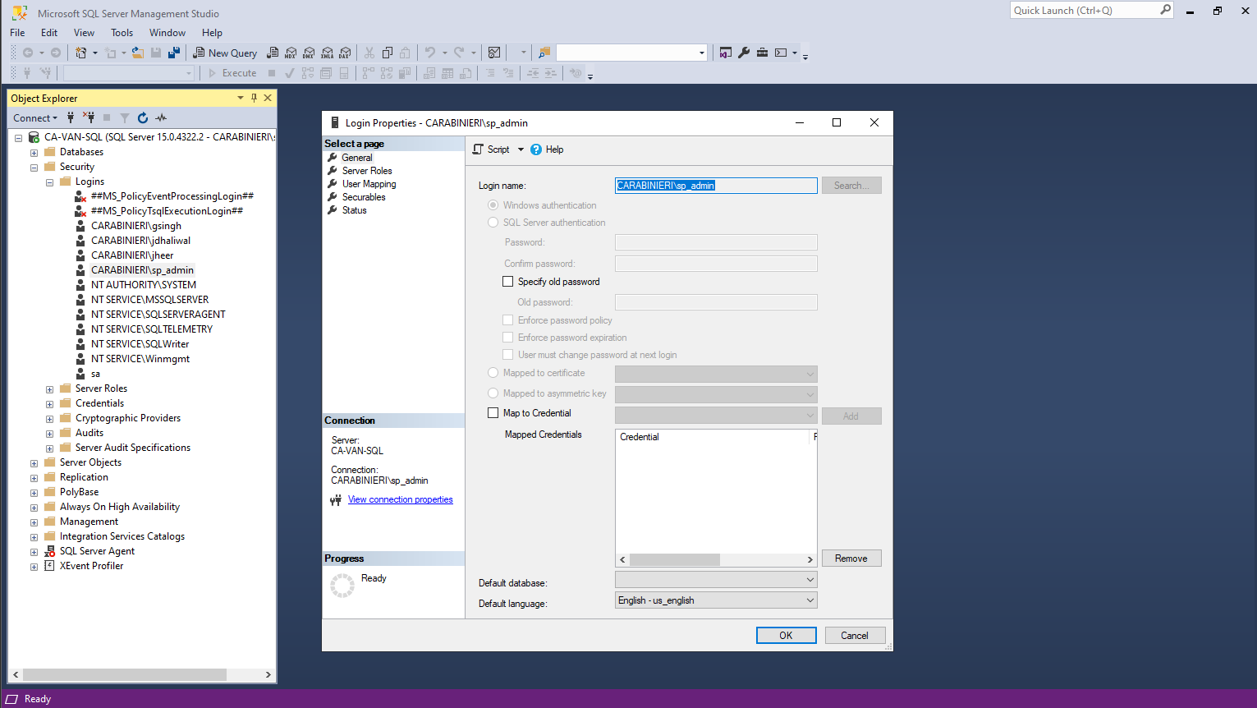
SQL Server
Notes:
The first thing we need to do is to go to security and pick your admin account to give him additional rights.
In case your sharepoint administrator account was not added you can just add it now by right clicking login

Slide 31
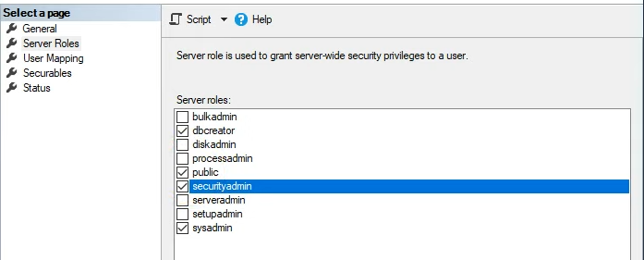
SQL Server
Notes:
These 4 roles are required. Once you select the required roles just press OK and restart the SQL server. Now we are done with step 2 and we will move on to step 3 which is installing the prerequirements for the sharepoint server

Slide 32
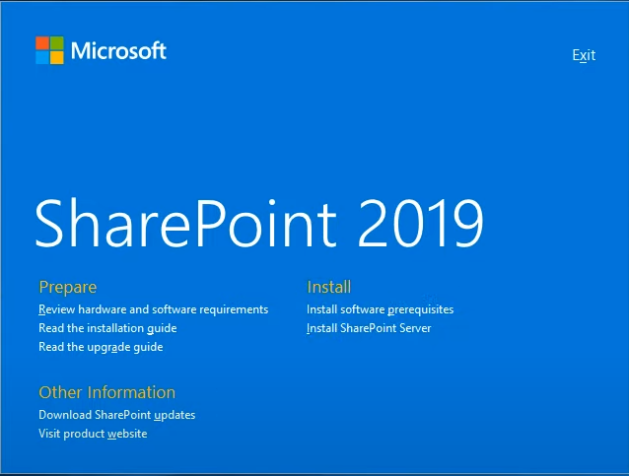
Install prerequisites for Sharepoint Server
Web Server (IIS) Role
Microsoft .NET Framework 4.8
Visual C++ Redistributable Package for Visual Studio 2015-2019
Notes:
Now we move to the SharePoint server and we click on the install software prerequisites. These 3 are the main once but there is more that the server will install automatically.

Slide 33
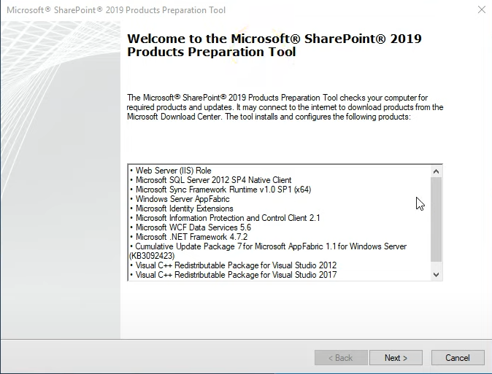
Install prerequisites for the Sharepoint Server
Notes:
Firstly the wizard will install the Web Server (ISS) Roles on the machine itself and while installation is in progress we can keep an eye on the programs section of control panel.

Slide 34
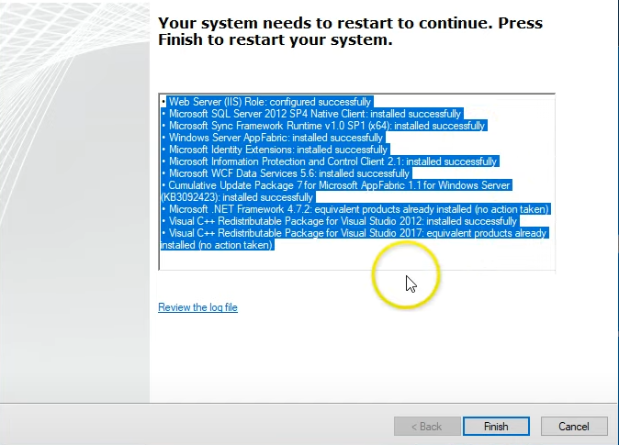
Pre-requisites for Sharepoint Servers
Notes:
Wait until everything is installed and then you will be required to reboot the entire server. After which we can run the Sharepoint Server. Make sure there is no errors while installation. In case there is any errors make sure you troubleshoot and resolve them or they will cause problems while running the sharepoint server.

Slide 35
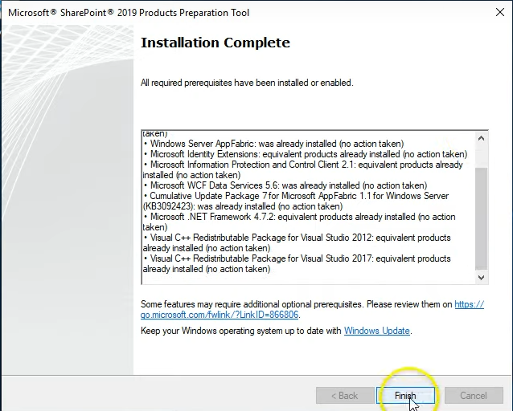
Installation of prerequisites Successful!
Notes:
once the reboot is complete it's going to relaunch the sharepoint server. this means we are now on step 4 "Which is RUN the sharepoint server installation".
Once you log onto the SharePoint server you will see the setup wizard should pop up automatically and in case it doesn't you can definitely launch it automatically. Click finish

Slide 36
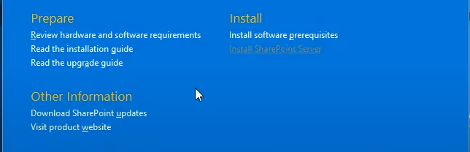
Time to install Sharepoint
Notes:
Now it’s time to install the sharepoint server itself.
The installation is pretty straight forward.
This installation is very similar to any Microsoft product installation and it doesn’t require any special steps.
You are going to need a browser to view the Sharepoint administrator console so in case you don’t have one on the VM you can install it at the same time so that you can save some time. Once the installation is completed you will be required to reboot again.

Slide 37
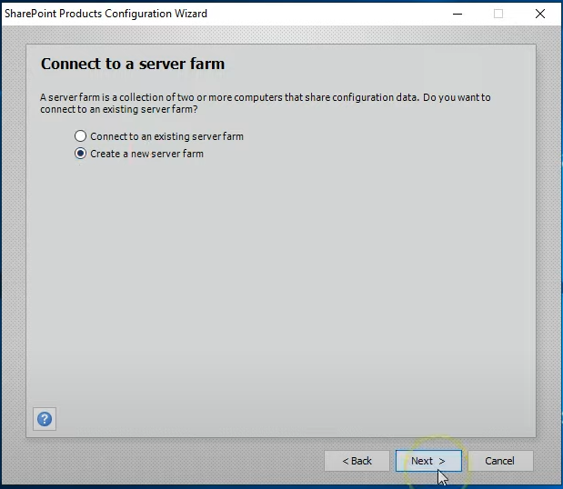
Configure SharePoint Server 2019
Notes:
Once the reboot is completed the setup wizard for the sharepoint should appear automatically. If you have a larger environment and you have distributed Sharepoint environment across multiple servers then you definitely need to ann existing farm. Or you can just click new server and create a new one, in this case because we aren’t really an enterprise level company we are just going to create a new one

Slide 38
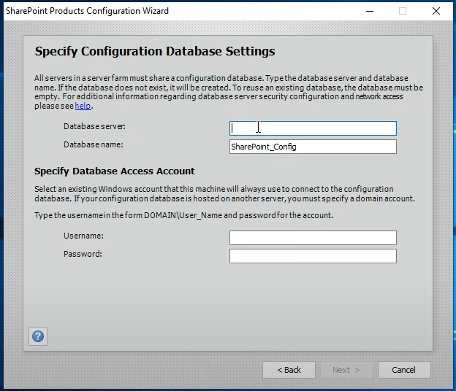
Configure SharePoint Server 2019
Notes:
Here is where you input the database server name of your choosing and for the username is the service account name for database access account. The admin account you are running on your database

Slide 39
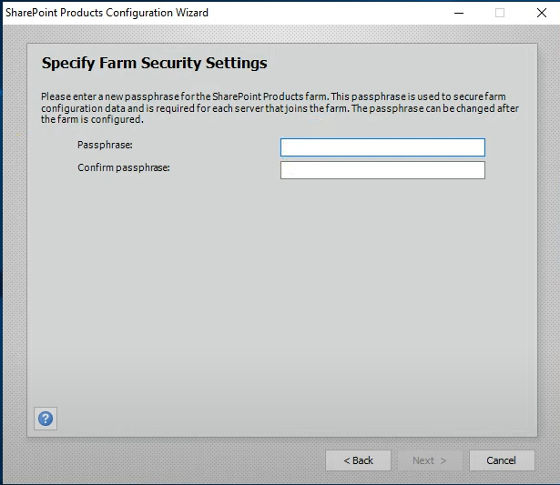
Configure SharePoint Server 2019
Notes:
If everything goes right you will see this window. If not it will give you errors relating to the how we can’t communicate to the SQL server. And type the passphase. (used to encrypt everything)

Slide 40
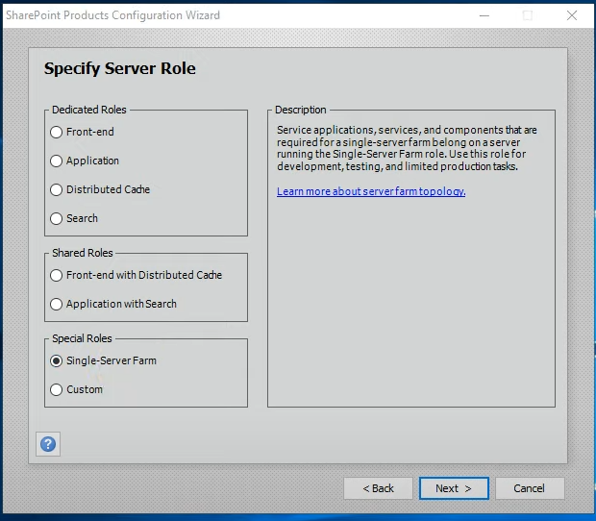
Configure SharePoint Server 2019
Notes:
In our case this is going to be a single farm which means all the roles are going to be installed on the server itself.

Slide 41
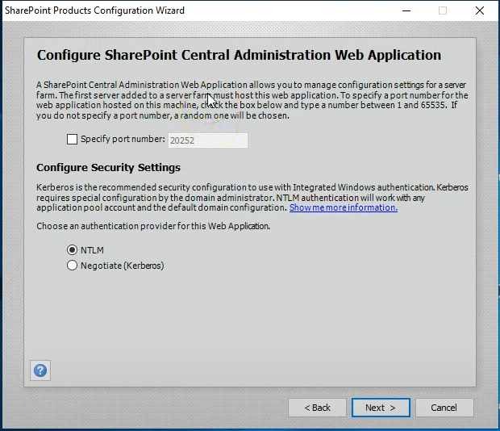
Configure SharePoint Server 2019
Notes:
Here you can speficy the port number manually or it’s going to take the automatically sharepoint administrator web page. And for authentication I just kept the default NTLM. After this step the installation is going to take place. And you will be able to see the database inside the SQL Manager. The installation is going to take quite some time as this is where all the configurations are implemented. Depending on the server performance and how much memory you put in inside your VM.

Slide 42
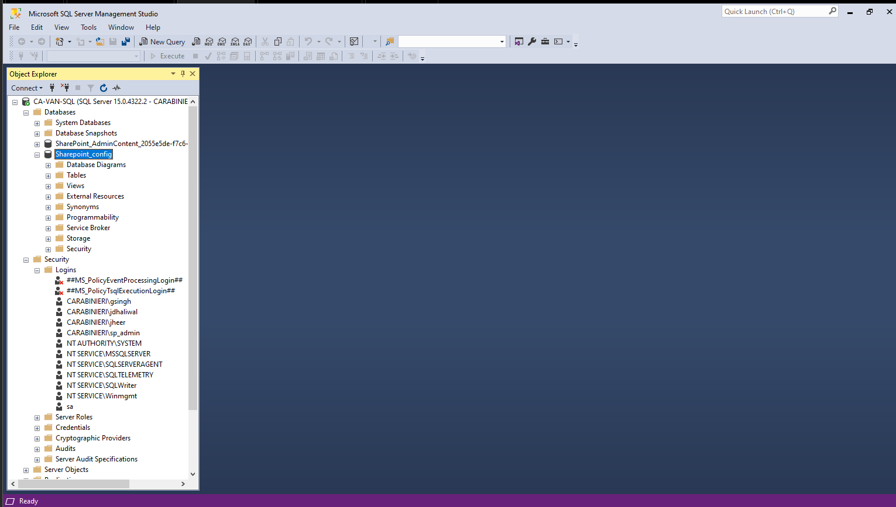
Database successfully created
Notes:
Once the installation is complete you can see the database you created inside the SQL Database manager. After this we can finally move to step 6

Slide 43
Settings applied to the server
Configuration Database Server Configuration Database Name Host the Central Administration Web Application Central Administration URL Authentication provider Local Server Role | Ca-VAN-SQL Sharepoint_config Yes http://ca-van-sp:9999 NTLM Single-Server Farm
Notes:
In our case these are the details we are going to implement. Make sure you remember and save that URL. That’s going to be very important for accessing the server online.

Slide 44
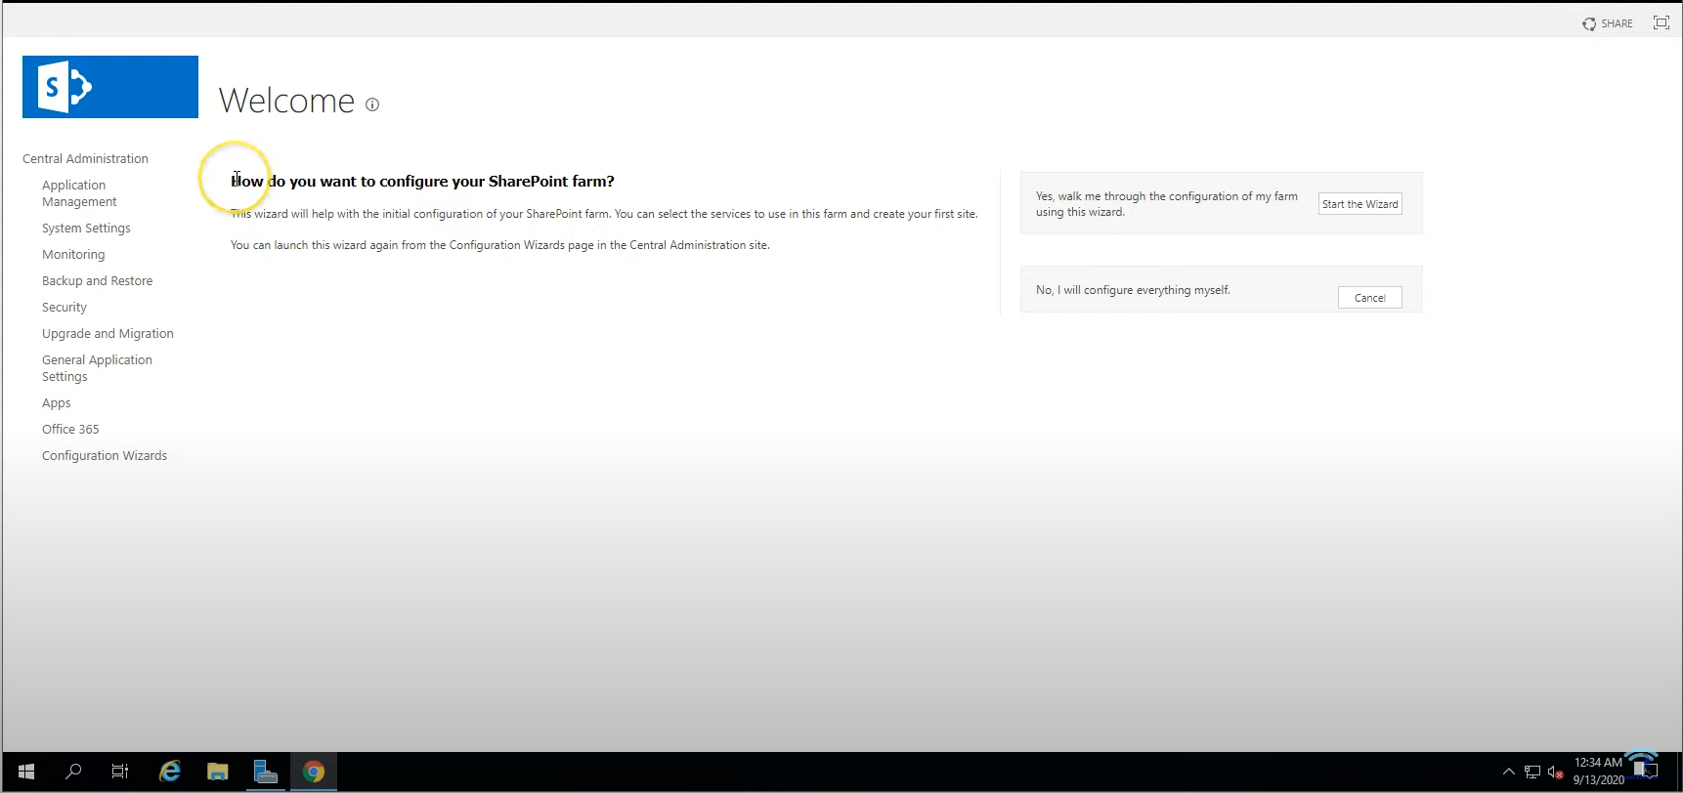
Validating the Sharepoint Installation
Notes:
If everything goes right, this window should automatically appear, this is basically the central administration setup wizard. and this is where you configure your sharepoint. Either you press cancel and configure it manually but what we did was automatic installation.

Slide 45
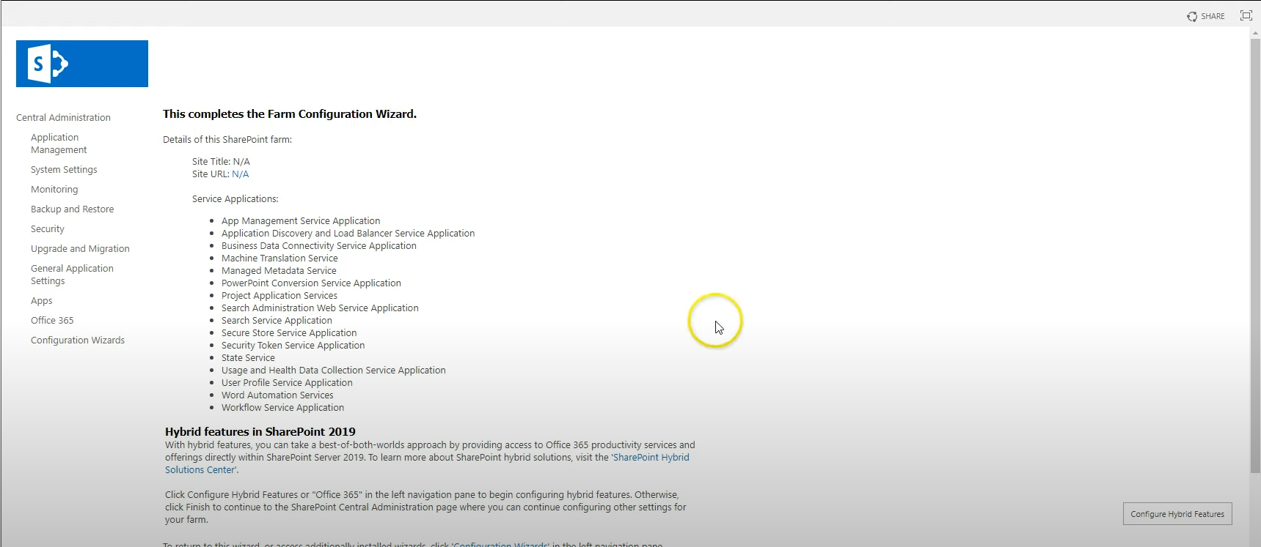
Farm configuration successful!

